Slide 1
Air Pollution Forecasting
Ong Qi Hao Tristan P2112659 DAAA/FT/2A/02

Slide 2
TABLE OF CONTENTS
01
02
03
04
05
06
Prediction Task
Background Research
Exploratory Data Analysis
What is the objective of this time series forecasting
What do we know about the problem?
Univariate and Bivariate Analysis
Preprocessing
Modelling
Model Improvement
How do we prepare our data so that its is ready for modelling?
Getting a rough idea of how each model performs
Selecting a few models to improve on

Slide 3
Prediction Task
To build an accurate time series forecasting model that can forecast the pollutants in the environment such as Carbon monoxide (CO), Hydrocarbon (HC), Nitrogen dioxide (NO2) and Ozone (O3).

Slide 4
Background Research
What is air pollution?
Simply put, chemicals in the atmosphere
What is it caused by?
Natural phenomenon such as volcanic eruptions
Man-made factors such as burning of fossil fuels in vehicles
What are its negative impacts?
Detrimental to the environment, plants etc
Detrimental to respiratory systems of humans and animals which can cause difficulty in breathing and in the worst cases, it might even lead to death

Slide 5
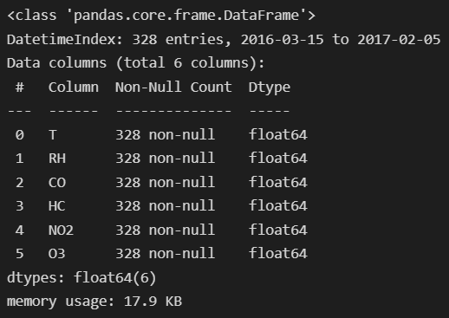
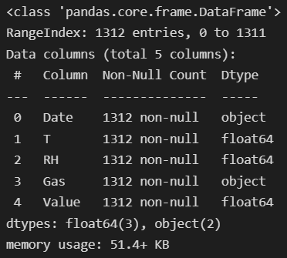
EDA - Univariate
Pivot
We can see that there are 5 columns in the original dataset with 2 categorical columns and 3 numerical columns, however, one of the categorical columns is actually in date form
We will then pivot the dataset into wide format and make each gas have its own column and we can see that the pivoted dataframe has 328 rows and 6 columns now and all of them are numerical

Slide 6
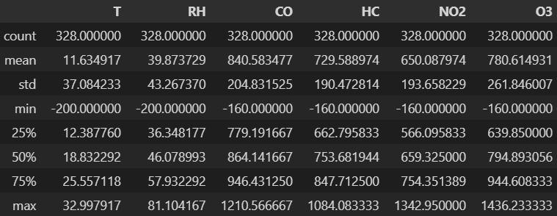
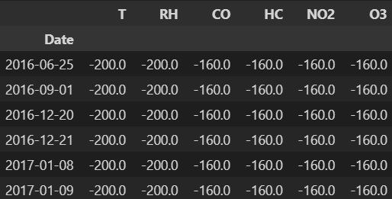
EDA - Univariate
We see that for every column, there seem to be a common minimum value
After some background research, I realised that missing values of this dataset has been tagged with a value of -200. After inspecting the missing values, we see that there only missing values under temperature and relative humidity.
However, we can see that there is a weird pattern that shows that for every row that relative humidity and temperature is null in, the gases have a value of -160 as well.

Slide 7
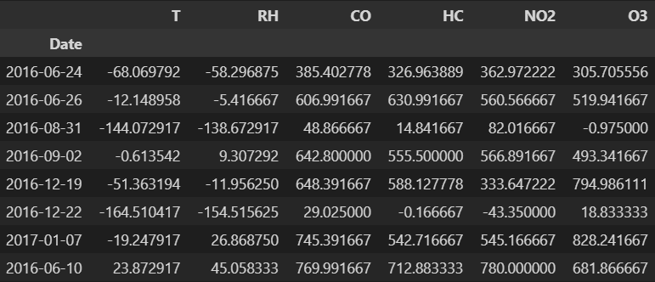
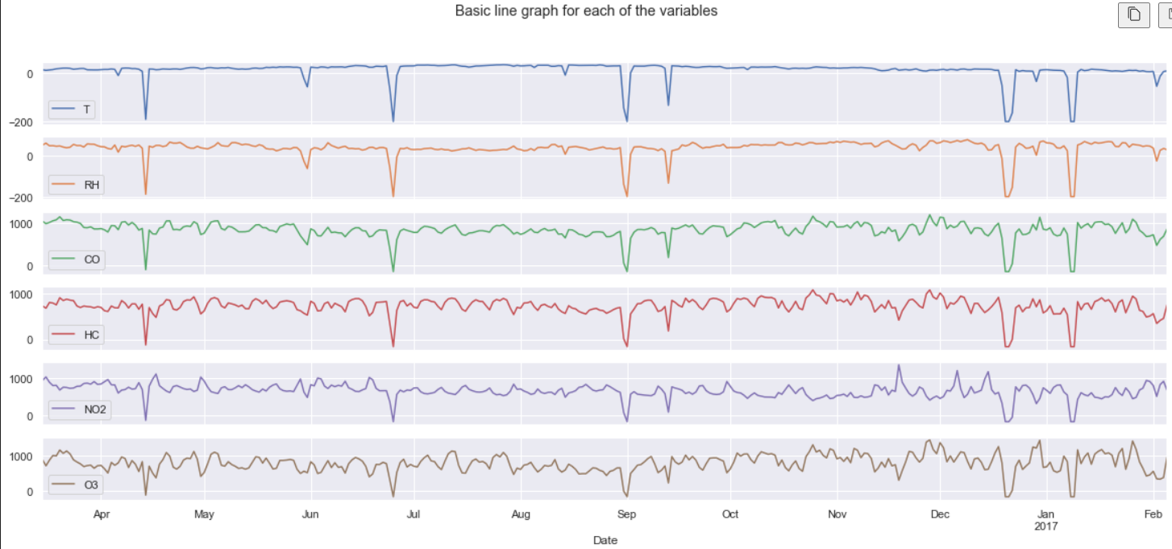
EDA - Univariate
The days before and after the days with null values also seem to have negative values which are impossible and that will be explained later on.
We can also see from the line graphs that there are sudden downward spikes which can be explained by the null values and impossible values.

Slide 8
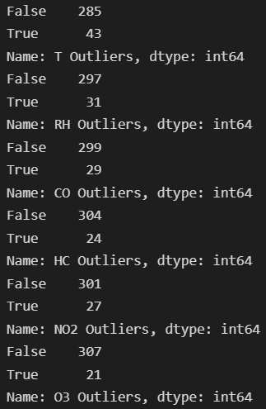
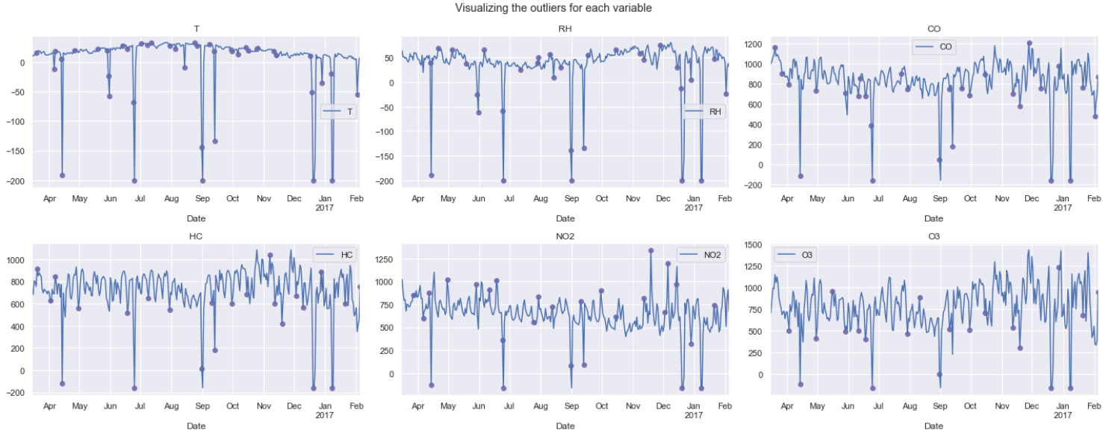
EDA - Univariate
Identifying outliers using Tukey’s Fences
However, we must keep in in mind that for time series, it would be illogical to use future data to assess past data. For that, we must perform Tukey's fences on a rolling basis and we can do that by using ‘.rolling’ provided by pandas
Although we see that there are many outliers in the dataset, we want to keep some of them so that our model will be robust to predicting outlier values as well.

Slide 9
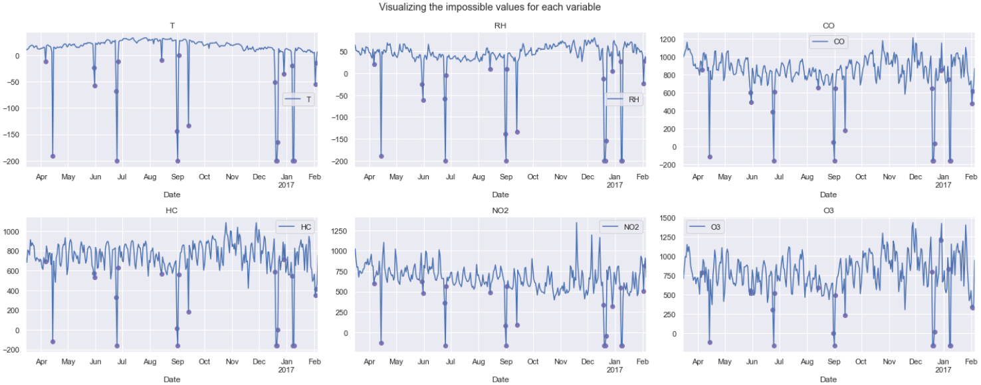
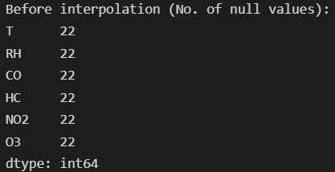
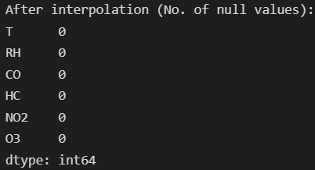
EDA - Univariate
Identifying impossible values
We can expect that there are 'impossible' values in our data as well. These are values that defy natural phenomena (e.g Negative percentage of relative humidity and negative gas values)
We will not be dropping the impossible/outlier values as this will create 'gaps' in our data, causing the periods to be irregular
Instead, we will be handling these values by interpolation and limiting the direction to forward only as we cannot interpolate past values using future values in time series data

Slide 10
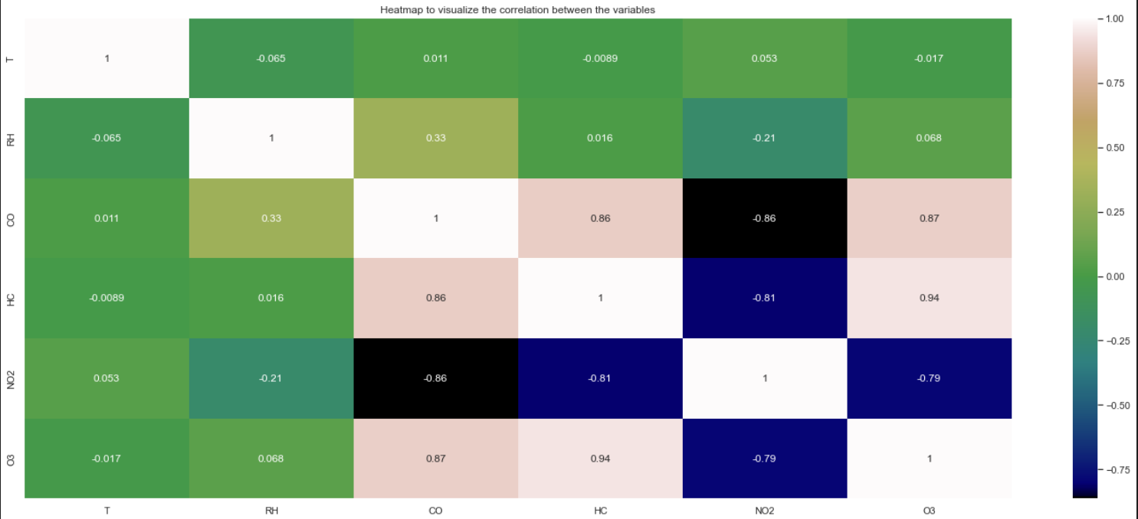
EDA - Bivariate
We plotted the correlation after applying percentage change – ‘pct_change()’. This is to avoid a spurious relationship which means that the statistical summaries show that the variables are related to each other but in fact, theoretically, there is no relationships between the two variables. Basically, avoiding incorrect results.
HC gas is highly correlated with all the other gases
Exogenous variables T and RH have low correlation with each other as well as with the other gases

Slide 11
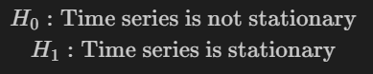
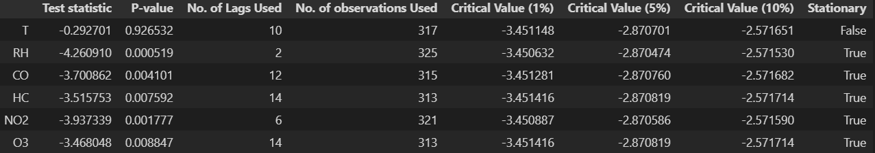
EDA – Statistical tests (Dickey-Fuller)
We can test for stationarity using the Augmented Dickey-Fuller unit root test at a significance level of 5% and if we find that the data is not stationary, we can transform the data or apply differencing to it.
Stationarity means that the statistical properties (i.e the mean and the variance) of the data do not change over time.
Since we know that the data for the gases are stationary, we would not have to perform any transformation or differencing to it
So, if we are using ARIMA models the sequence will follow ARIMA(p,0,q) where p and q will be decided later using the correlograms of autocorrelation and partial autocorrelation

Slide 12
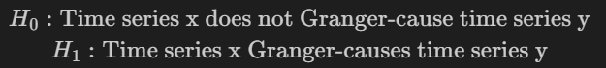
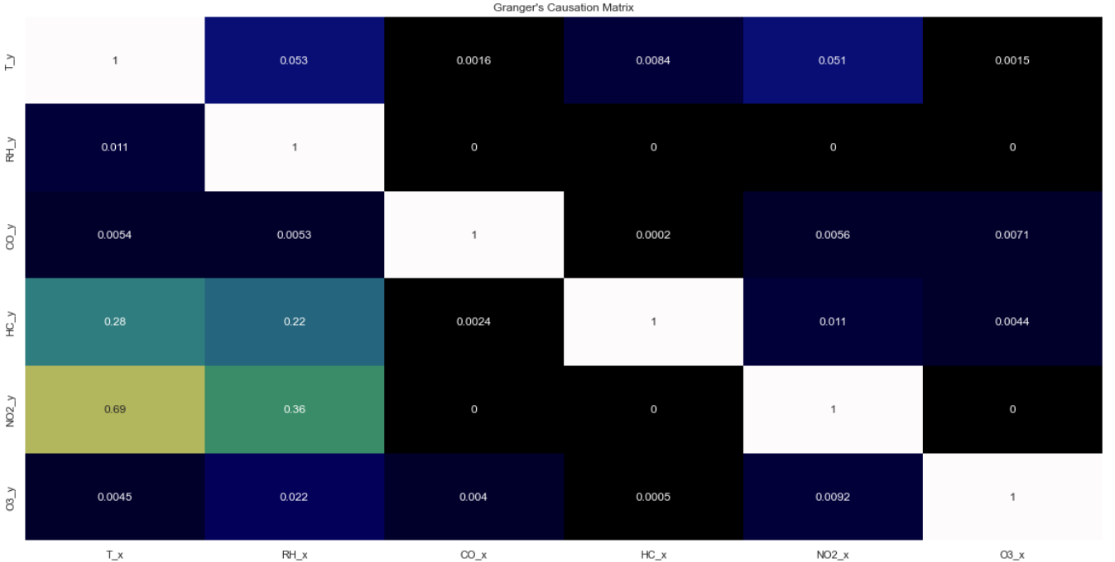
EDA – Statistical tests (Granger’s Causality)
We perform Granger's Causality Test at a significance level of 5% to see if the variables in the time series are interchangeably causing each other.
We want there to be some causation between the variables so as to justify multivariate modelling
We can see that most of the p-values between variables from the Granger's Causality Test are less than 0.05 which means that they are interchangeably causing one another.
This gives us the 'GO' sign to implement multivariate modelling.

Slide 13
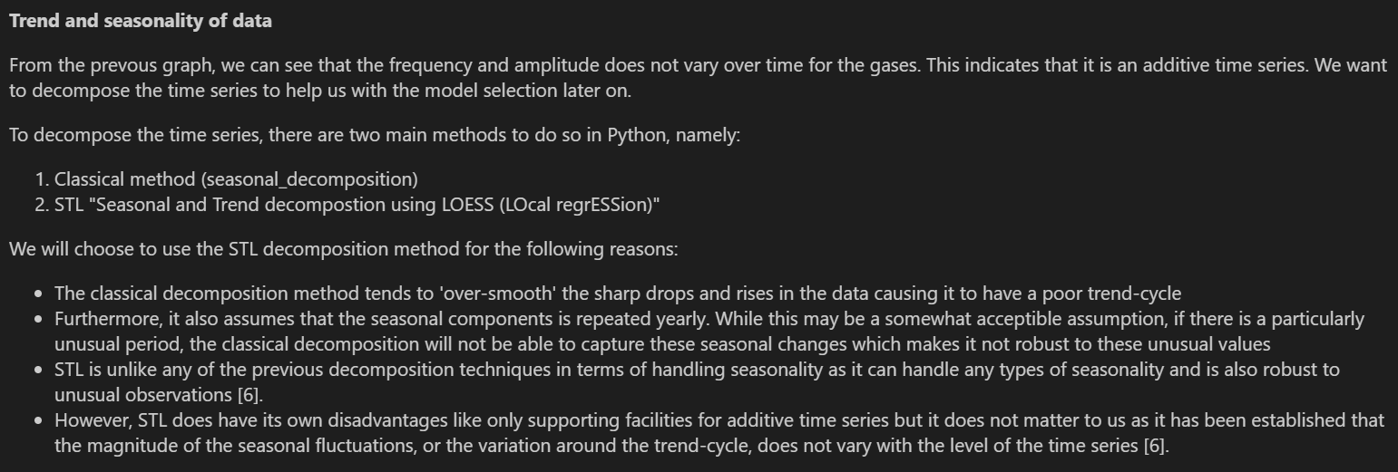
EDA – Trend and Seasonality

Slide 14
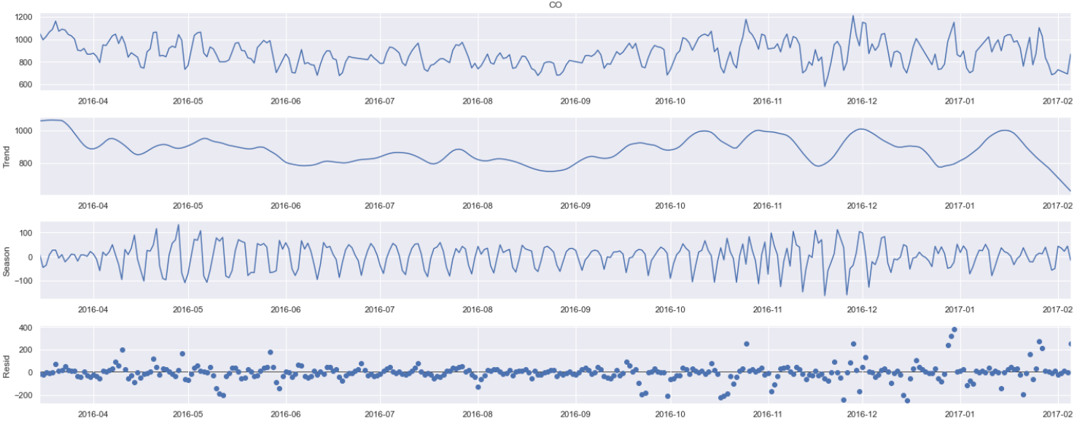
EDA – Trend and Seasonality (CO)
The trend for Carbon Monoxide shows that there is a downward trend from April 2016 to September 2016 and the trend changed upwards from September 2016 to February 2017
The seasonal component shows that there is weekly seasonality for Carbon monoxide emissions
We can see that the residual values become larger and larger over time, indicating more noise as time passes

Slide 15
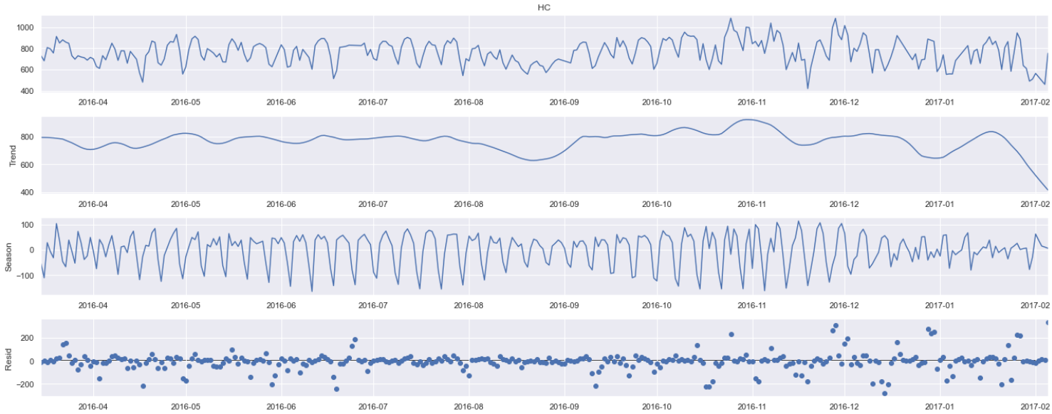
EDA – Trend and Seasonality (HC)
There seems to be a downward trend overall for Hydrocarbon except for a short one month upward trend from mid August 2016 to November 2016
There also seem to a weekly seasonality as seen from the seasonal components having four recurring patterns per month
Similarly for the residuals, there seem to be more noise over time as the residuals get larger over time especially between December 2016 and February 2017

Slide 16
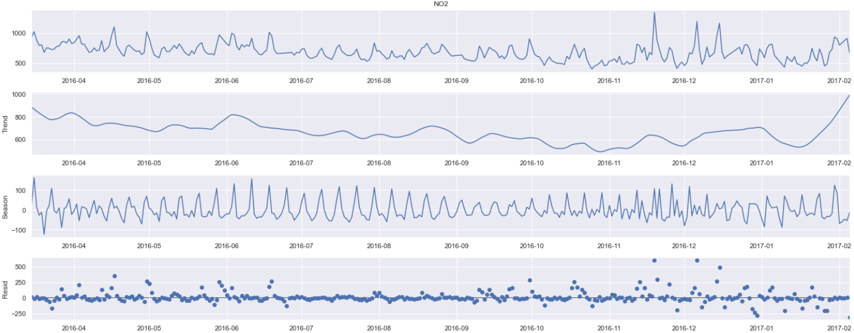
EDA – Trend and Seasonality (NO2)
There is an obvious downward trend from the start of 2016 to the end of 2016 but there is a sudden upward trend at the start of 2017
Seasonal component shows there is weekly seasonality as well for Nitrogen dioxide emissions
Residuals seem to be more stable as compared to Carbon monoxide and Hydrocarbon, indicating less noise

Slide 17
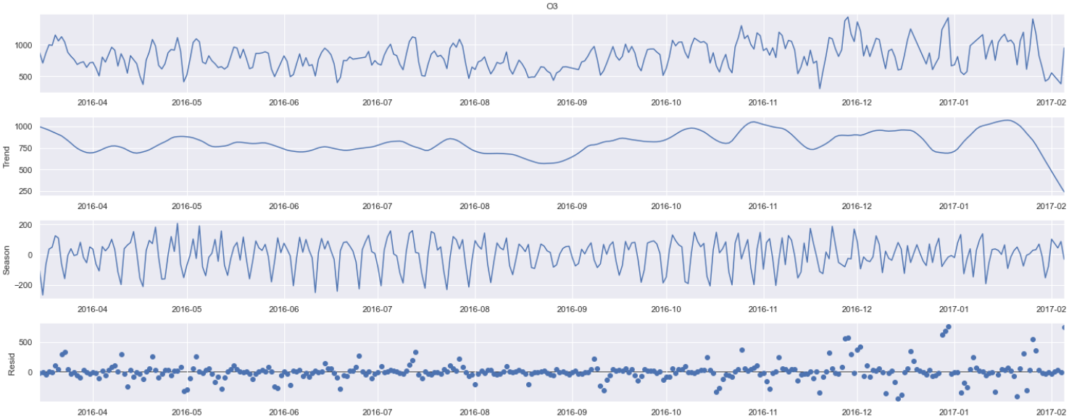
EDA – Trend and Seasonality (O3)
There seems to be a constant trend for Ozone from April 2016 to August 2016 and from then on there was a upward trend all the way till January 2017
Ozone has weekly seasonality as well as we can see from the repeating patterns of 4 every month
There is quite a lot of noise in late 2016 to early 2017 as wee can see that the residual values are larger there

Slide 18
Modelling/Model Selection
Smoothing
Vector autoregressive
Metrics
Unobserved Components
ARIMA family
Exponential Smoothing
Holt-Winters
ARIMA, ARIMAX
SARIMA, SARIMAX
RMSE
AIC
BIC
VARMA
VARMAX
UCM
UCMX

Slide 19
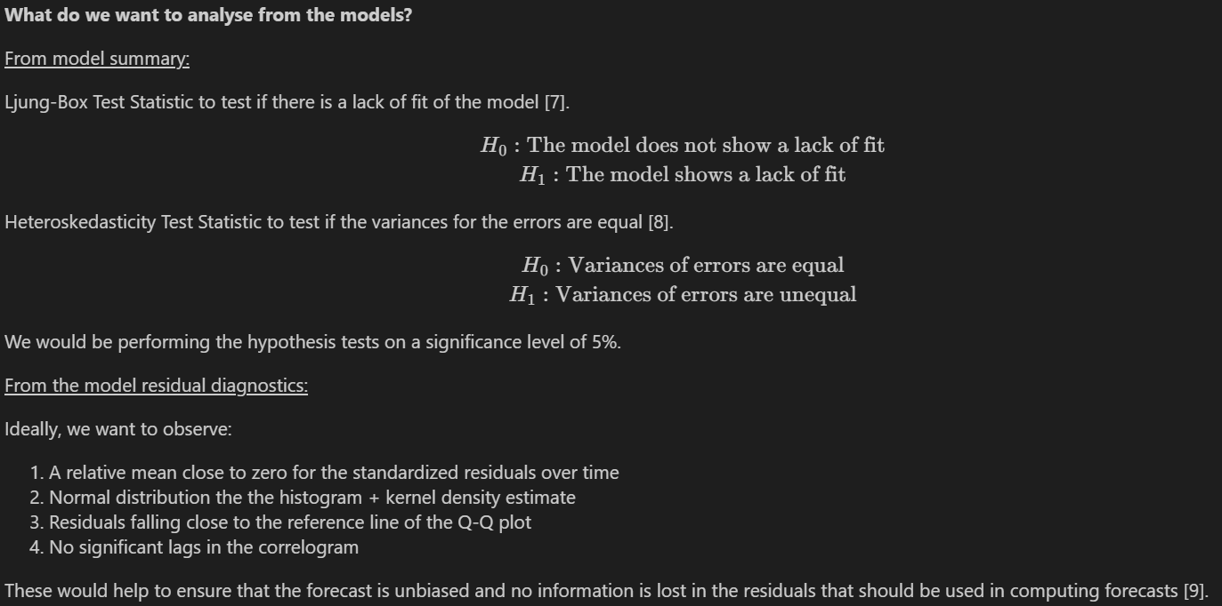

Slide 20
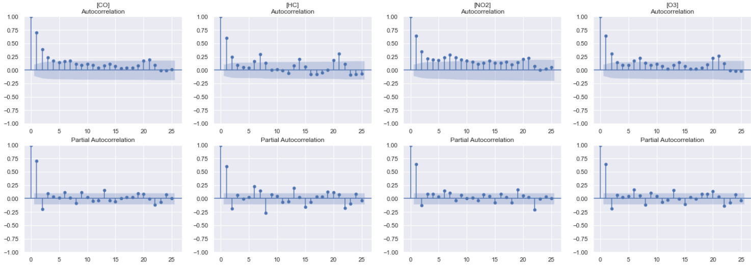
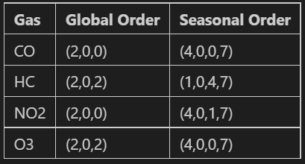
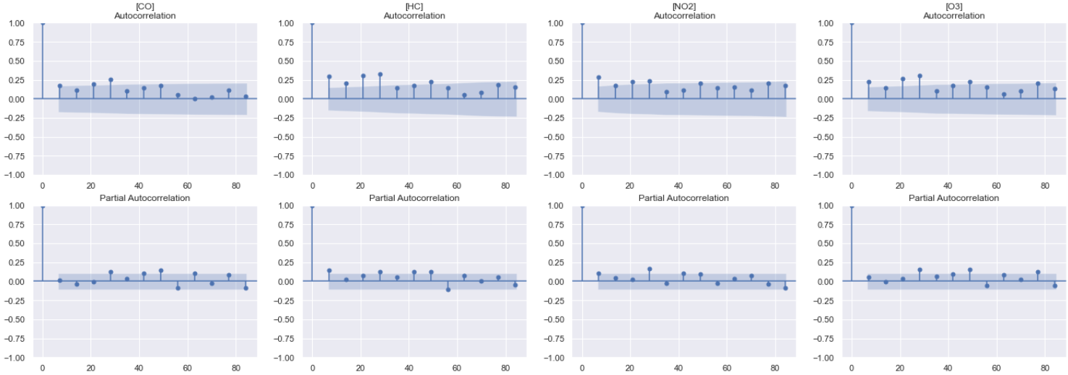
ACF and PACF Plots
Global
Seasonal

Slide 21
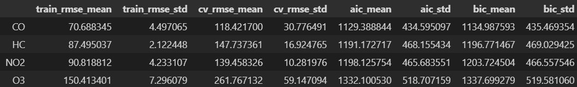

Smoothing models
Exponential Smoothing
We can see that exponential smoothing model performs averagely based on the cross-validated RMSE scores. But the standard deviations of the cross-validated RMSE scores are quite high indicating that the model is unstable, especially for gas O3 with a standard deviation of 59.147094.
Holt-Winters
The Holt-Winters exponential smoothing model performs extremely bad with high cross-validated RMSE scores. Furthermore, the standard deviations of the cross-validated RMSE are in the hundreds, indicating that it is a very unstable model that cannot produce consistent results.

Slide 22
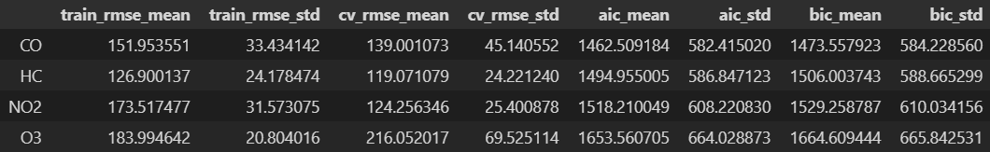
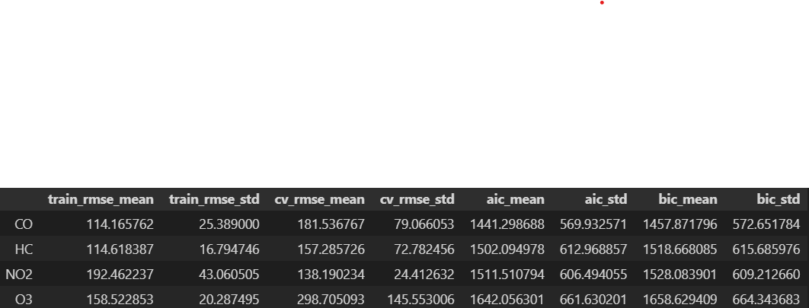
Unobserved components
UCM
Unobserved components model without exogenous models show that the model performance is average based on the cross-validated RMSE scores but it also unstable as the deviation in cross-validated RMSE scores are of a considerable amount.
UCMX
Similarly with unobserved components but with exogenous variables, the cross-validated RMSE scores deviate quite a lot thus it is unstable. However, it performed worse with exogenous variables as it has higher cross-validated RMSE scores on average.

Slide 23
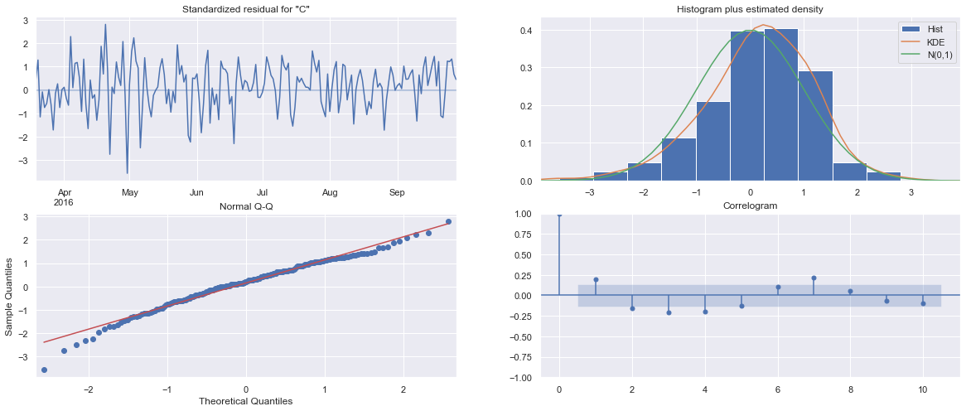
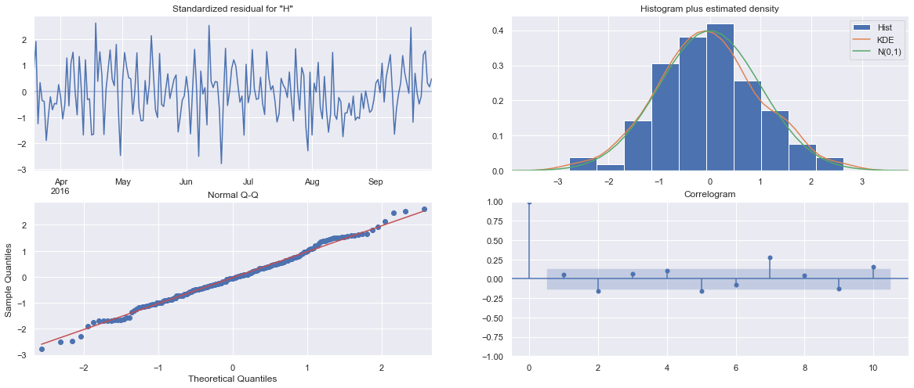
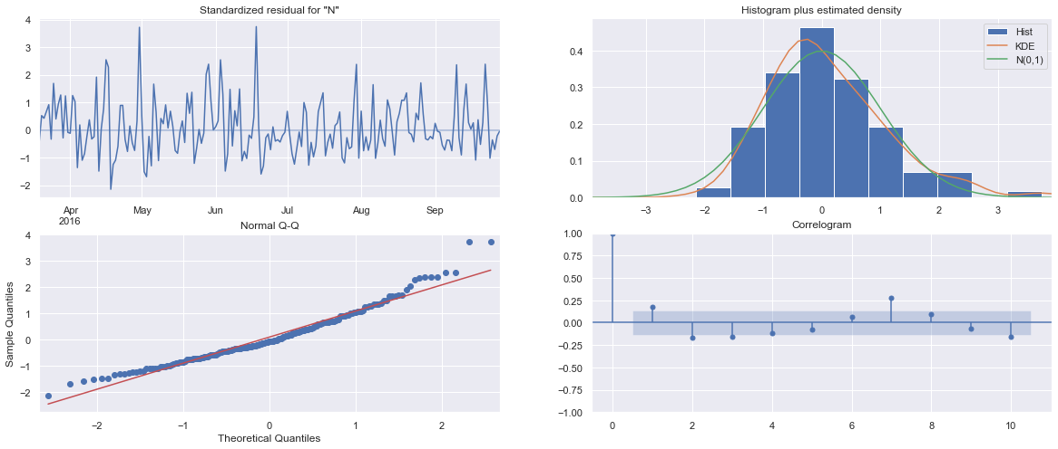
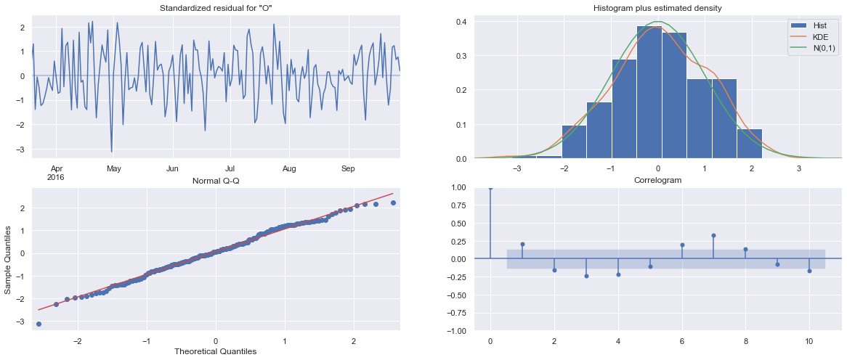
Unobserved Components - UCM

Slide 24
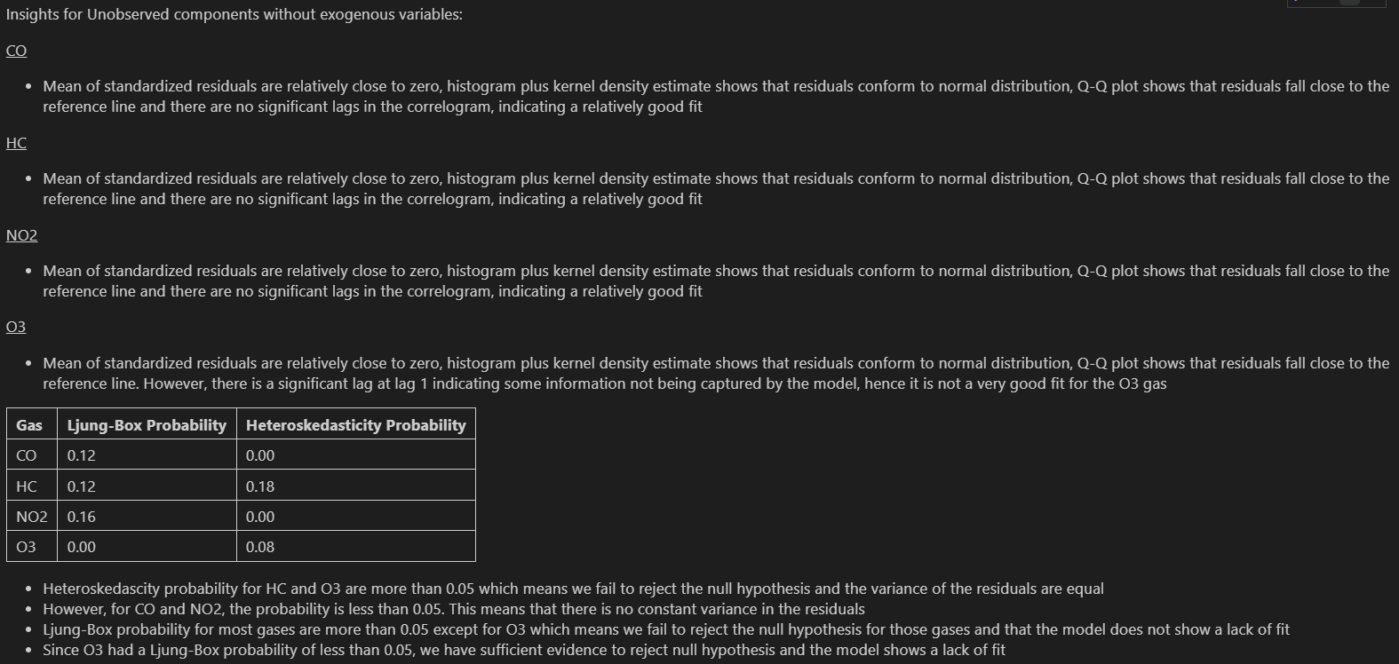
Unobserved Components - UCM

Slide 25
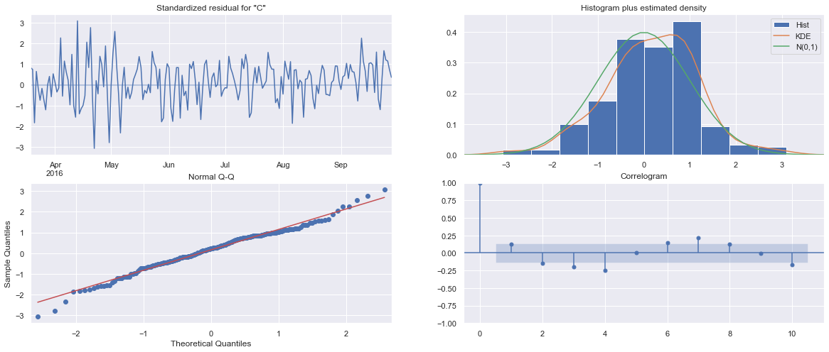
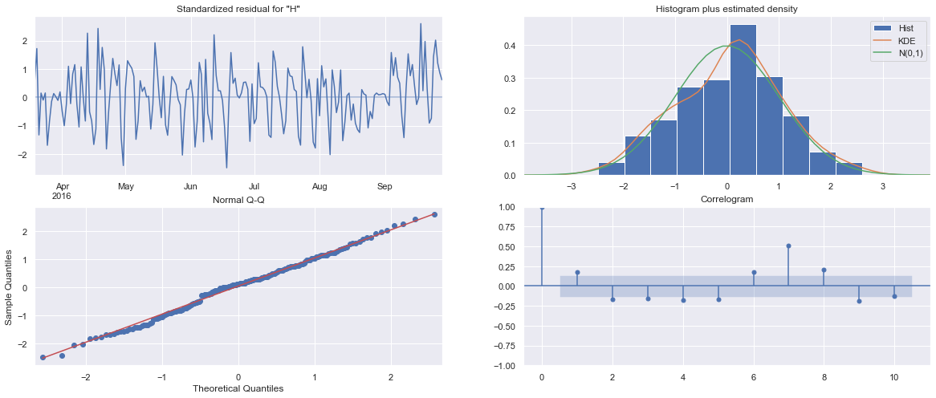
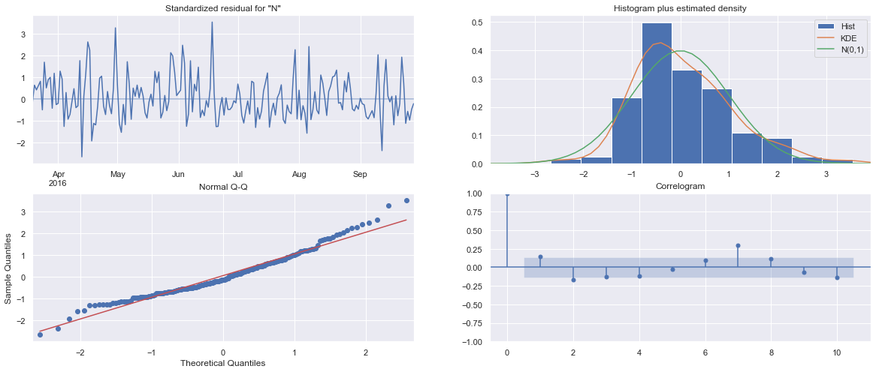
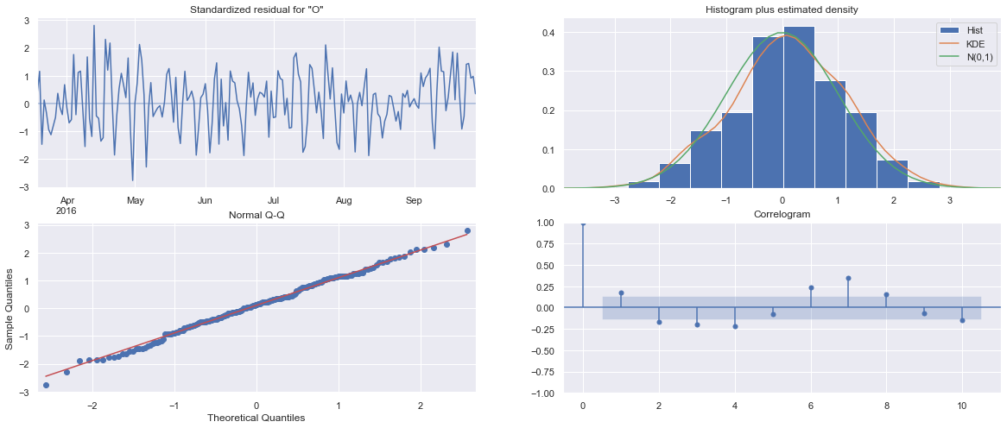
Unobserved Components - UCMX

Slide 26
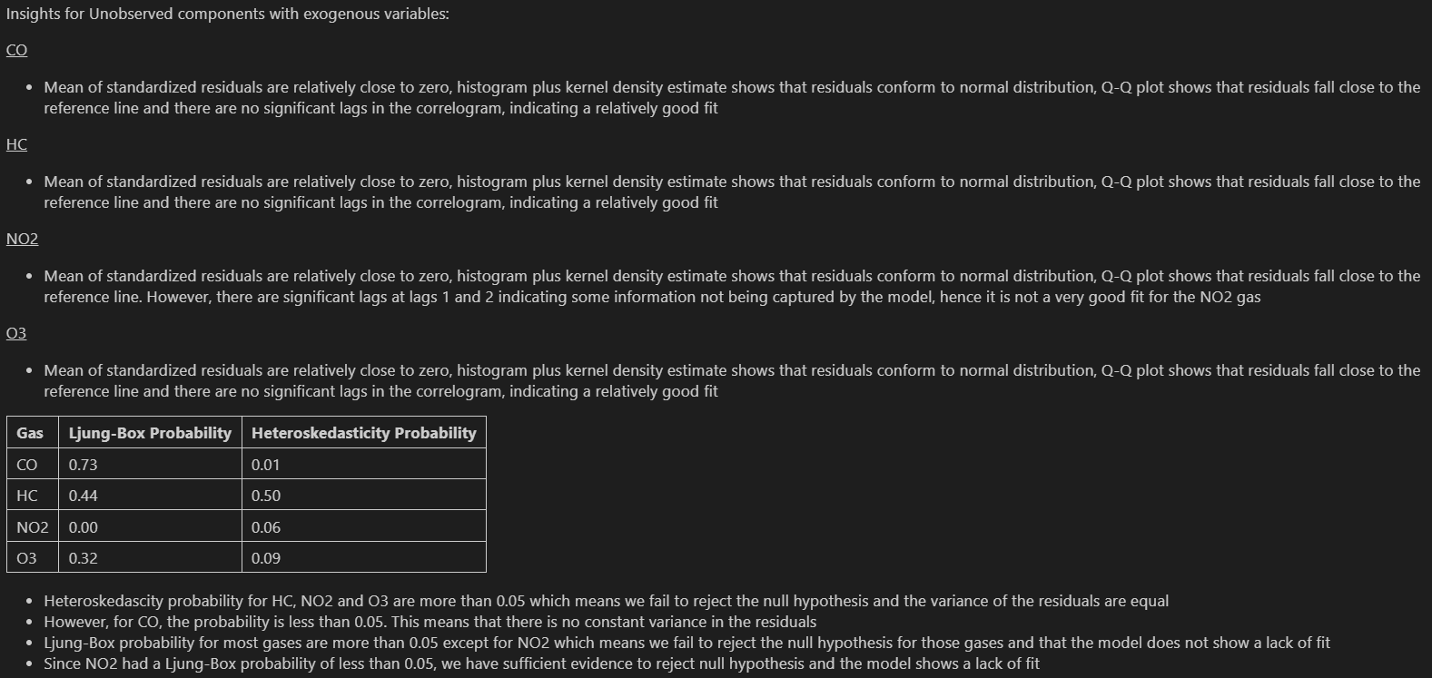
Unobserved Components - UCMX

Slide 27
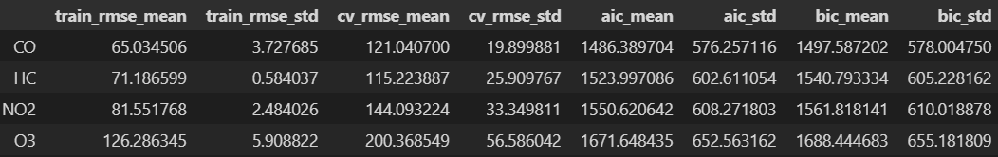
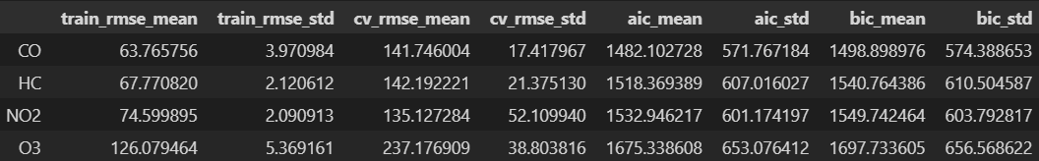
ARIMA family models
ARIMA
For the ARIMA model without exogenous variables, the scores of the cross-validated RMSE seems to perform better than the previous models and it also has lower standard deviation in cross-validated RMSE scores.
ARIMAX
ARIMAX, the ARIMA model with exogenous variables seem to perform worse than without exogenous variables.

Slide 28
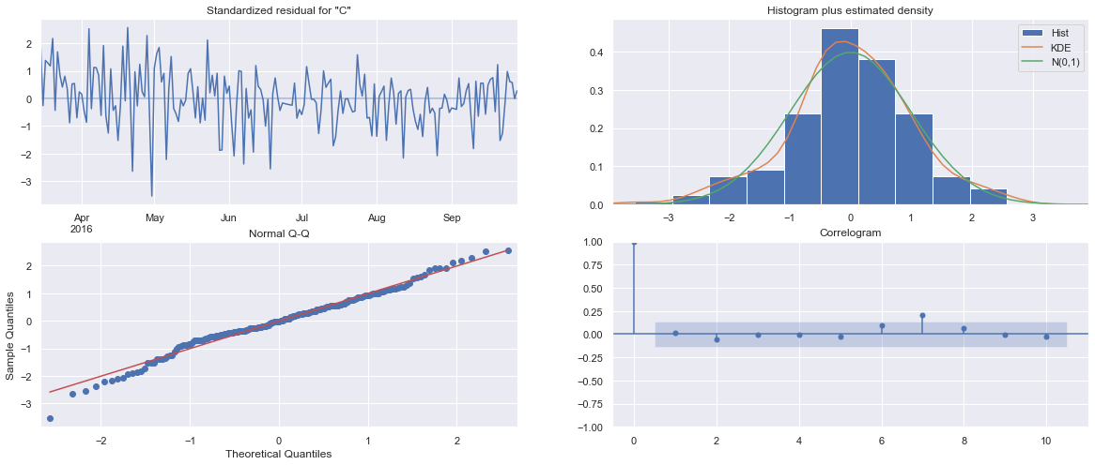
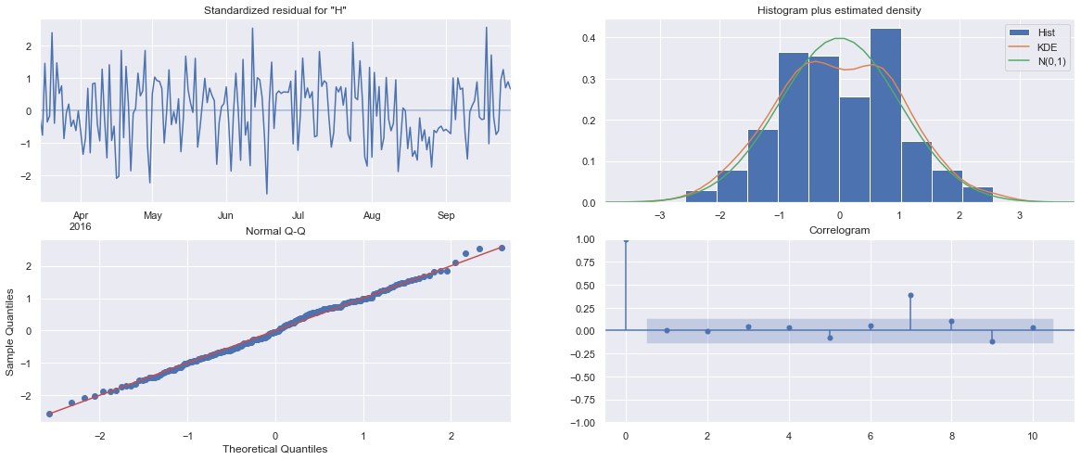
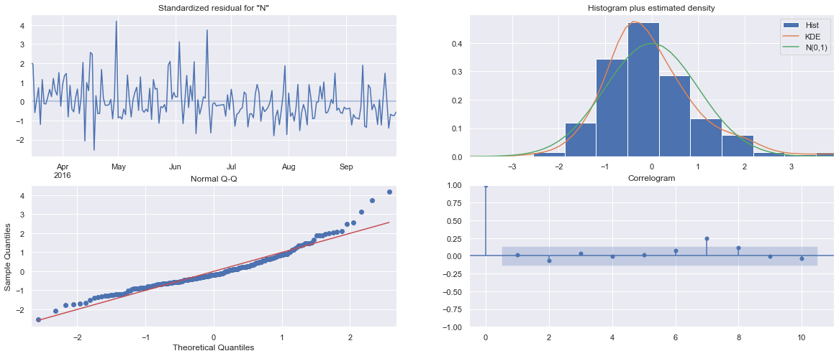
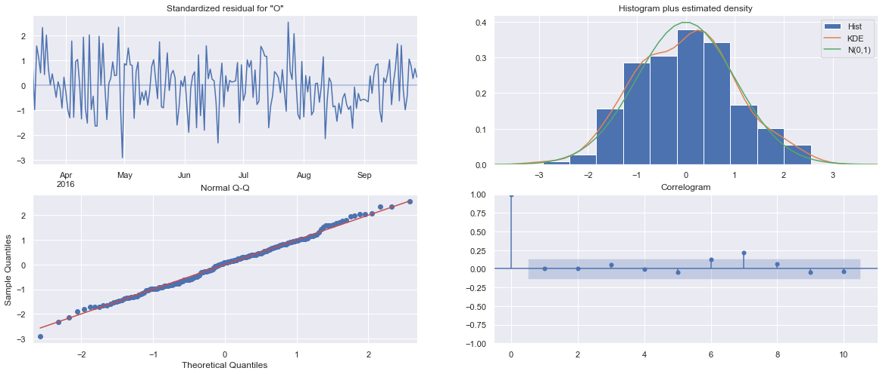
ARIMA family models - ARIMA

Slide 29
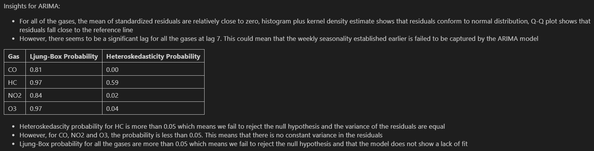
ARIMA family models - ARIMA

Slide 30
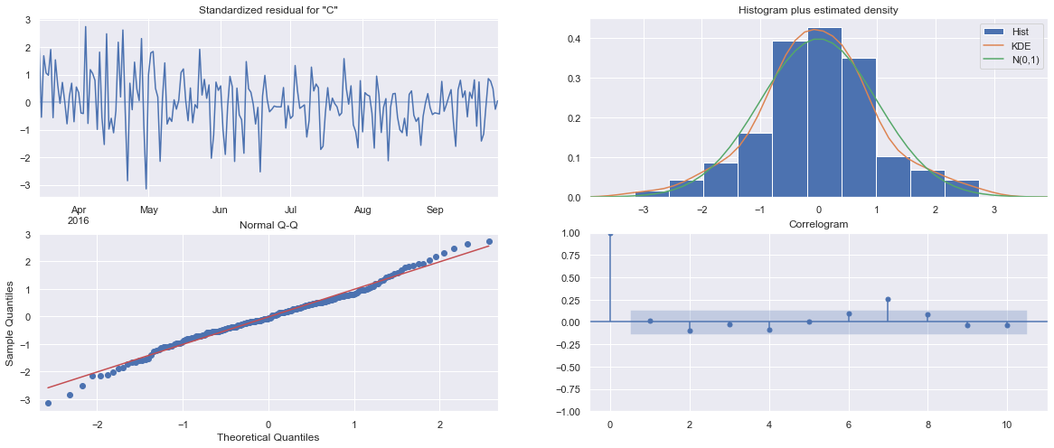
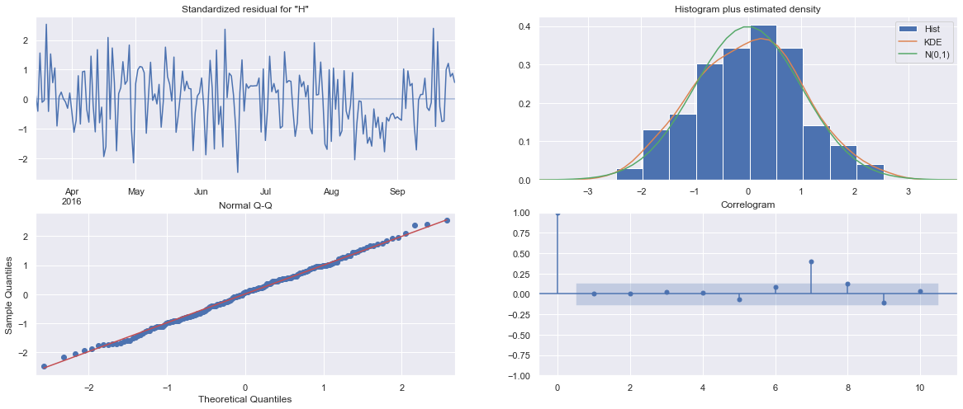
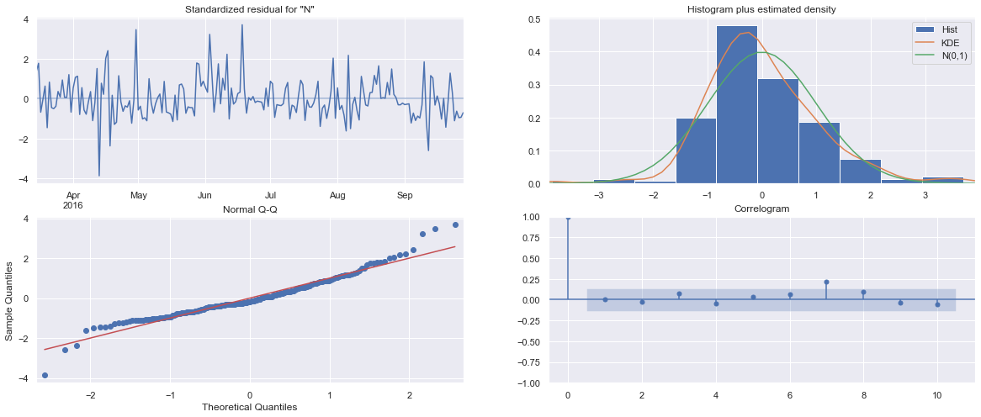
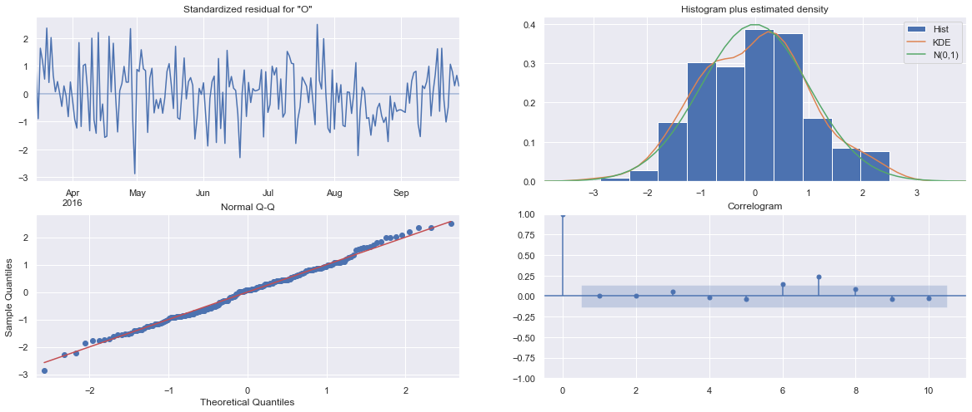
ARIMA family models - ARIMAX

Slide 31
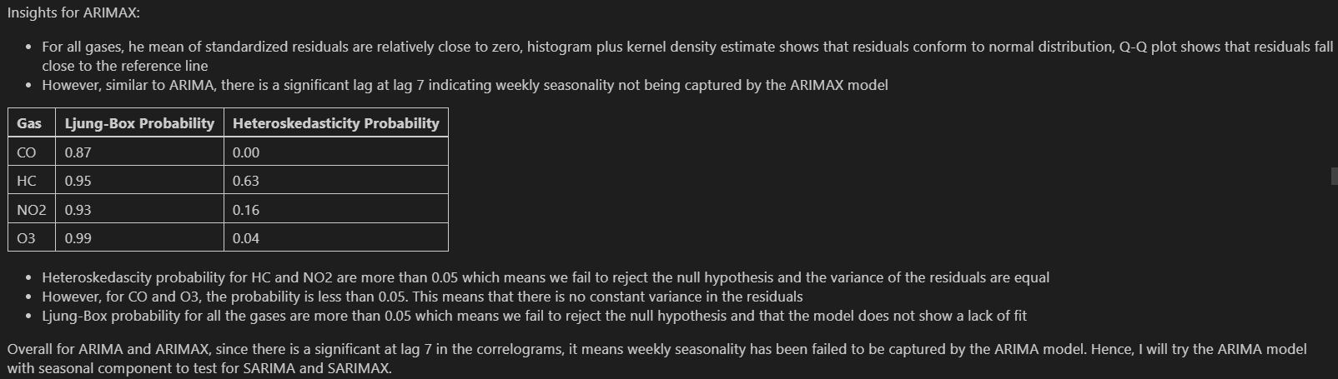
ARIMA family models - ARIMAX

Slide 32


ARIMA family models
SARIMA
SARIMA showed that the cross-validated RMSE returned quite good results but have high standard deviation in cross-validated RMSE scores, suggesting the model is unstable.
SARIMAX
Similar to the relationship between ARIMA and ARIMAX, SARIMAX, seem to perform worse than SARIMA which is without the exogenous variables. However, we can see that the standard deviation for the cross-validated RMSE scores are much lower indicating a more stable model.

Slide 33




ARIMA family models – SARIMA

Slide 34

ARIMA family models – SARIMA

Slide 35




ARIMA family models – SARIMAX

Slide 36

ARIMA family models – SARIMAX

Slide 37
Vector Autoregressive models
VARMA
Using the VARMAX model, without the exogenous variables, VARMA performs quite well with a low cross-validated RMSE score of 145.27213 and considerably low standard deviation in cross-validated RMSE scores of 32.737111.
VARMAX
Similar to the relationship between ARIMA and ARIMAX, SARIMA and SARIMAX, VARMAX model with exogenous variables seem to peform worse than the VARMAX model without exogenous variables. Returning a cross-validated RMSE score of 159.067063 and standard deviation in cross-validated RMSE scores of 26.539917.

Slide 38




ARIMA family models – VARMA

Slide 39

ARIMA family models – VARMA

Slide 40




ARIMA family models – VARMAX

Slide 41

ARIMA family models – VARMAX

Slide 42
Model Improvement
Feature engineering
Hyperparameter Tuning
Dew point
Is Weekend
Tune the Auto Regressive and Moving Average components of the model

Slide 43




Feature Engineering
ARIMAX
UCMX
SARIMAX
VARMAX

Slide 44
Hyperparameter Tuning
We want to conduct hyperparameter tuning to further find the best set of parameters that can improve our model.
I also intend to tune VARMAX with both the added exogenous variable 'Dew point' and 'Is Weekend' and ARIMA model with seasonal components with and without exogenous variables (SARIMAX and SARIMA) for all the gases to find the best parameters and further shortlist the models.
Why didn't I tune the other models?
I chose not to tune for the smoothing models (Exponential Smoothing) because they are not robust to predicting for outlier values
For Unobserved Components, there is significant auto correlation the residuals, indicating a poor fit, this tells me the unobserved components probably will not return my desired results
For ARIMA and ARIMAX, they fail to capture the seasonality, hence it is not a suitable model for this dataset

Slide 45


Hyperparameter Tuning – Vector Autoregressive models
VARMA
VARMAX
From the grid search, we can see that when q=0, the cross-validated RMSE values are better than the orders when p=0.
Hence, I will only shortlist the best combination of p and q for VARMA and VARMAX:
VARMA((8,0))
VARMAX((2,0))
VARMA((8,0)) returned the best cross-validated RMSE score for VARMA combinations.
VARMAX((2,0)) returned the best cross-validated RMSE score for VARMAX combinations.

Slide 46



Hyperparameter Tuning – SARIMA and SARIMAX models
SARIMA
I tuned the models from (0,0,0)(0,0,0,0) to (3,0,3)(3,0,3,7)
These are the best set of parameters for SARIMA and SARIMAX respectively
We will be using SARIMAX as our final model as the model seems to be the most stable with lowest mean standard deviation for cross-validated RMSE as compared to the other models. On top of that, it captures the seasonality such that it maximizes the data and leaves no important data in the residuals that can be used to compute forecasts.
SARIMAX

Slide 47





Model Evaluation
The SARIMAX combinations performed very well with an RMSE of 168.47658881643267.
We can see that there is some autocorrelation in the residuals for CO and this could be because of the seasonal order for the model that predicts for CO. The seasonal parameters were (0,0,0,7) which means that there is no seasonal order at all, hence, we will try the next best combination of parameters where there is seasonal order.
Next best order for CO:

Slide 48

Model Evaluation
The SARIMAX combinations performed quite well with an RMSE of 172.26219860399596 on an unseen test set.
We see that we minimized the issue of autocorrelation in the residuals and we can proceed with the final part of this time series forecasting task. Basically, we did a trade-off for low autocorrelation in the residuals for RMSE score.

Slide 49

Final Model
Conclusion on the final model and parameters:
Ljung-Box Probability for all gases indicate that the p-value is greater than 0.05, which means that the model does not show a lack of fit.
Finally, we would train the SARIMAX model with the final parameters using the whole dataset and then predict for Kaggle.

Slide 50




Final Model Diagnostics
For all the gases, the mean of standardized residuals are relatively close to zero, histogram plus kernel density estimate shows that residuals conform to normal distribution, Q-Q plot shows that residuals fall close to the reference line and the correlograms show no significant lags, indicating a good fit

Slide 51

Final Model Diagnostics
Heteroskedascity probability for HC, NO2 and O3 are less than 0.05 which means we have sufficient evidence to reject the null hypothesis and the variance of the residuals are not constant
However, the residuals follow a normal distribution as seen from the histogram plus kernel density estimate plot and sometimes, the data fails the heteroskedasticity test because there is too little data
Hence, for more reliable analysis, we will follow the visualization from the histogram plus kernel density plot and that the residuals follow a normal distribution and thus have constant variance
Ljung-Box probability for all the gases are more than 0.05 which means we fail to reject the null hypothesis and that the model does not show a lack of fit for the gases

Slide 52


Visualizing final predictions

Slide 53
THANKS!
I have successfully built a time series forecasting model for air pollutants. I hope to learn more about time series and build more models for predicting different tasks
Please keep this slide for attribution

